Slide 1
DSP First, 2/e
Lecture 22
IIR Filters: Feedback
and H(z)

Slide 2
License Info for DSPFirst Slides
This work released under a Creative Commons License with the following terms:
Attribution
The licensor permits others to copy, distribute, display, and perform the work. In return, licensees must give the original authors credit.
Non-Commercial
The licensor permits others to copy, distribute, display, and perform the work. In return, licensees may not use the work for commercial purposes—unless they get the licensor's permission.
Share Alike
The licensor permits others to distribute derivative works only under a license identical to the one that governs the licensor's work.
Full Text of the License
This (hidden) page should be kept with the presentation

Slide 3
READING ASSIGNMENTS
This Lecture:
Chapter 10, Sects. 10-1, 10-2, & 10-3
Other Reading:
Optional: Ch. 10, Sect 10-4
FILTER STRUCTURES

Slide 4
LECTURE OBJECTIVES
IIR: Infinite-Length Impulse Response
SYSTEM FUNCTION: H(z)
FEEDBACK Difference Equations
THREE-DOMAIN APPROACH

Slide 5
LECTURE OBJECTIVES
INFINITE IMPULSE RESPONSE FILTERS
Define IIR DIGITAL Filters
Filters with FEEDBACK
use PREVIOUS OUTPUTS
Show how to compute the output y[n]
Derive Impulse Response h[n]
Derive z-transform: h[n] ←→ H(z)

Slide 6
THREE DOMAINS
Z-TRANSFORM-DOMAIN
POLYNOMIALS: H(z)
TIME-DOMAIN
FREQ-DOMAIN

Slide 7
Quick Review: Delay by n_{d}
Difference Equation
IMPULSE RESPONSE
SYSTEM FUNCTION
Frequency Response

Slide 8
Quick Review: L-pt Averager
Difference Equation
IMPULSE RESPONSE
SYSTEM FUNCTION
Frequency RESPONSE

Slide 9
Recall: CASCADE Equivalent
Multiply the System Functions
x[n]
y[n]
x[n]
y[n]
EQUIVALENT
SYSTEM

Slide 10
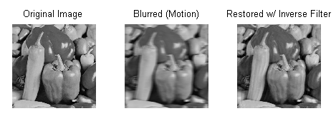
Motivation: DEconvolution
Ex: Remove optical blur in postprocessing?

Slide 11
Deconvolution Filter
System to remove optical blur in postprocessing
Given h₁[n], can we find h₂[n] to make y[n] equal to s[n]?
s[n]
x[n]
y[n]

Slide 12
Deconvolution in Z-DOMAIN
Hard to solve for h₂[n] in convolution sum
z-domain? Y(z) = H₂(z)H₁(z)S(z)= H(z)S(z)
s[n]
x[n]
y[n]
Not FIR

Slide 13
IIR FILTERS
IIR = infinite impulse response; the impulse response h[n] has infinite length
FIR: is a weighted sum of inputs, so the current output value does not involve previous output values, only the input values
IIR: the current output value involves previous output values (feedback) as well as input values

Slide 14
First Order IIR – ONE FEEDBACK TERM
ADD PREVIOUS OUTPUTS
FIR PART of the FILTER
PREVIOUS
FEED-FORWARD
FEEDBACK
CAUSALITY: NOT USING FUTURE OUTPUTS or INPUTS

Slide 15
FILTER COEFFICIENTS
ADD PREVIOUS OUTPUTS
MATLAB
yy = filter([3,-2],[1,-0.8],xx)
SIGN CHANGE

Slide 16
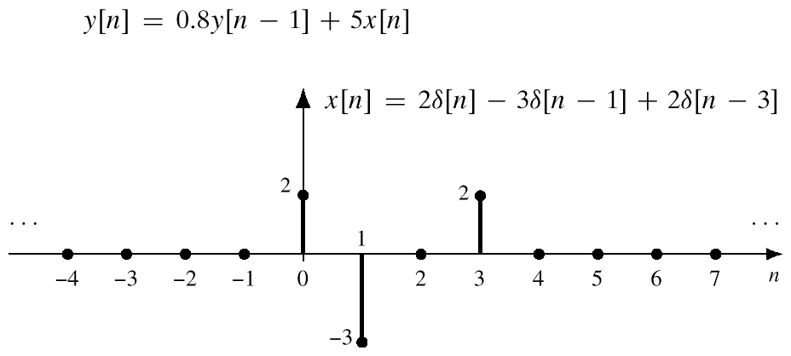
COMPUTE OUTPUT

Slide 17
COMPUTE y[n]
FEEDBACK DIFFERENCE EQUATION:
NEED y[-1] to get started

Slide 18
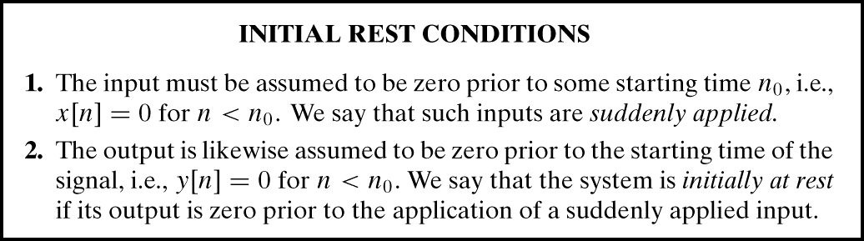
AT REST CONDITION
y[n] = 0, for n<0
BECAUSE x[n] = 0, for n<0

Slide 19
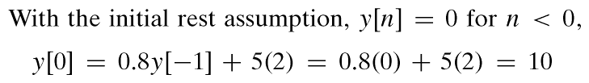
COMPUTE y[0]
THIS STARTS THE RECURSION:
SAME with MORE FEEDBACK TERMS

Slide 20
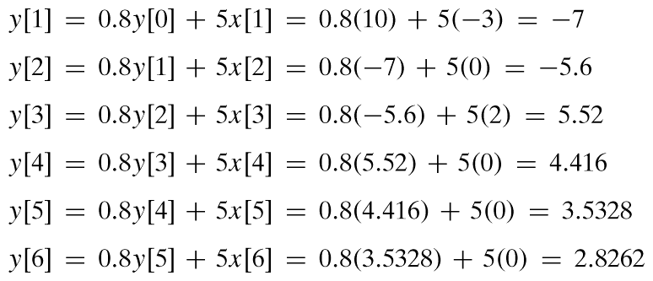
COMPUTE MORE y[n]
CONTINUE THE RECURSION:
Continues @ (0.8)^{n-3}
No more input

Slide 21
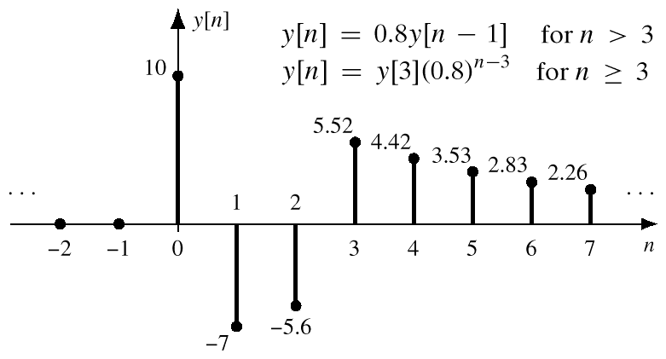
PLOT y[n] (infinite length)

Slide 22
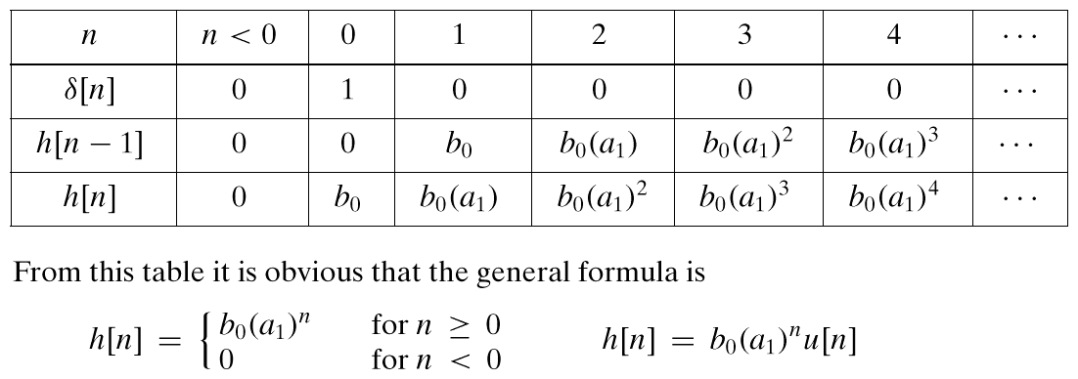
IMPULSE RESPONSE

Slide 23
IMPULSE RESPONSE
DIFFERENCE EQUATION:
Find h[n]
CONVOLUTION in TIME-DOMAIN
IMPULSE RESPONSE
LTI SYSTEM

Slide 24
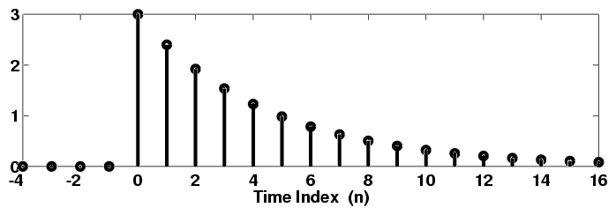
PLOT IMPULSE RESPONSE
5
At every index increment, only 80% of value retained

Slide 25
Infinite-Length Signal: h[n]
POLYNOMIAL Representation
SIMPLIFY the SUMMATION in IIR
APPLIES to
Any SIGNAL

Slide 26
Derivation of H(z)
Recall Sum of Geometric Sequence:
Yields a COMPACT FORM

Slide 27
H(z) = z-Transform{ h[n] }
FIRST-ORDER IIR FILTER:
The impulse response is infinitely long.
But, the filter is specified by only a few coefficients –
The order is finite.

Slide 28
Find H(z) from DE via ALGEBRA

Slide 29
H(z) = z-Transform{ h[n] }
ANOTHER FIRST-ORDER IIR FILTER:

Slide 30
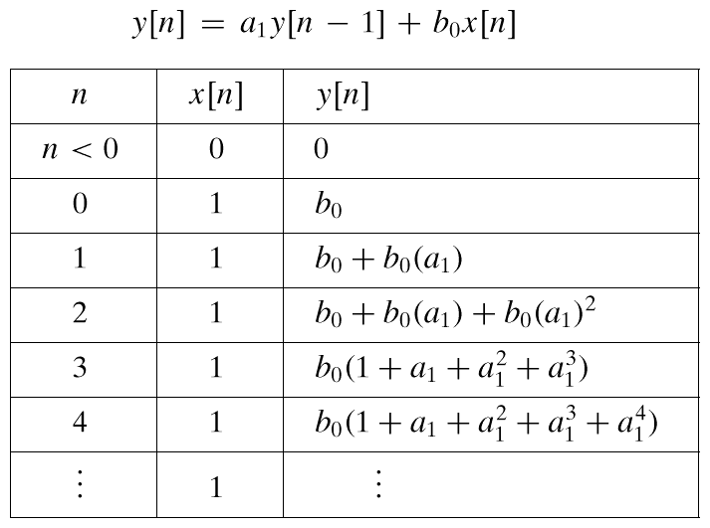
STEP RESPONSE: x[n]=u[n]

Slide 31
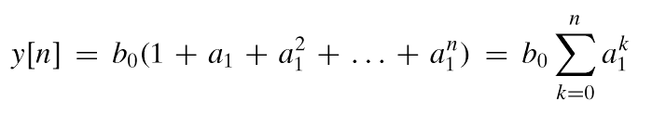
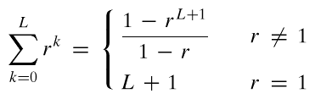

DERIVE STEP RESPONSE

Slide 32
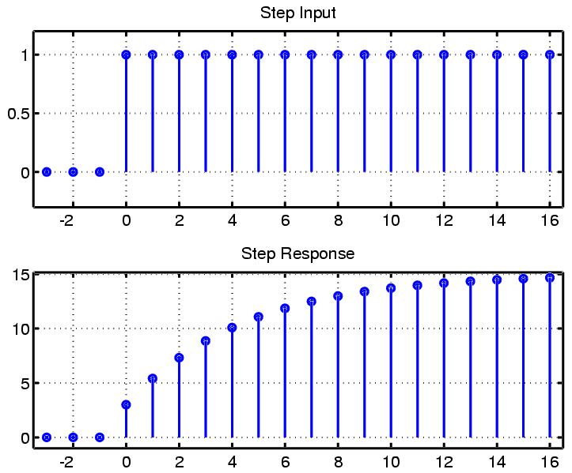
PLOT STEP RESPONSE

Slide 33
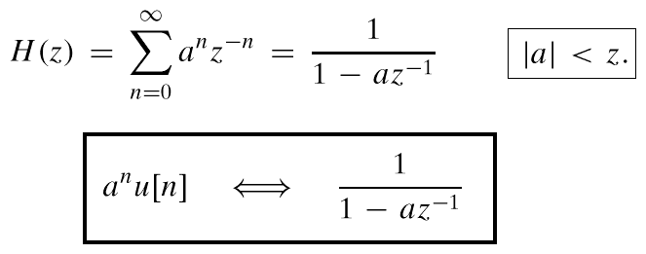
H(z) = z-Transform{ h[n] }
FIRST-ORDER CASE:

